Slide 1
Structure and use of the system of environmental and green growth indicators in the Russian Federation
THE SHARED ENVIRONMENTAL INFORMATION SYSTEM AND GREEN GROWTH: Regional Workshop for countries of Eastern Europe, Caucasus and Central Asia, 10-11 March 2015, Paris, France
N. Shashlova, Deputy Head of the Department of Statistics of Agriculture and the Environment, Rosstat
G. Fomenko, dr. of geographic sciences, professor, Chairman of the Board, Institute “Cadaster”
Dr. M. Fomenko, Deputy Executive Director, Institute “Cadaster”
A. Terentyev, Head of the Centre of International Cooperation, Scientific-Technical Centre “Resources and Consulting”

Slide 2
Main international standards for formation of environmental indicators
International guidelines and recommendations | Year of issue | International organizations participating in the development of a document
Basic principles of the development of environmental statistics (revised version) | 2013 | UN Statistical Division
Environmental indicators and environmental performance reviews: Eastern Europe, Caucasus and Central Asia | 2007 | UN ECE
Statistics of environmental expenditures: sectoral recommendations on the organization of data collection | 2005 | European Commission, Eurostat
Global strategy on the improvement of rural and agricultural statistics | 2010 | FAO

Slide 3
Legal base and norms for the development of environmental indicators
Federal Law № 7-FZ of 10.01.2002 "On Environmental Protection" (as amended on July 21, 2014),
Federal Law № 96-FZ of 04.05.1999 "On Air Protection"(as amended and supplemented),
Federal Law № 89-FZ of 24.06.1998 "On production and consumption wastes" (as amended and supplemented),
The Land Code of the Russian Federation № 136-FZ of 25.10.2001 (as amended and supplemented),
The Water Code of the Russian Federation № 74-FZ of 03.06.2006 (as amended and supplemented),
Forest Code of the Russian Federation № 200-FZ of 04.12.2006 (as amended and supplemented),
Federal Law № 33-FZ of 14.03.1995 "On Specially Protected Natural Territories" (as amended and supplemented),
Federal Law № 209-FZ of 24.07.2009 "On Hunting and on the Preservation of Hunting Resources and on Amending Certain Legislative Acts of the Russian Federation“ (as amended and supplemented),
Federal Law № 52-FZ of 24.04.1995 «About the animal world» (as amended and supplemented),

Slide 4
Continuation
Federal Law № 149-FZ of July 27, 2006 "On Information, Information Technologies and Information Protection" (as amended and supplemented),
Federal Law № 382-FZ of 29.11.2007 "On Official Statistical Accounting and the System of State Statistics in the Russian Federation" (as amended),
Federal plan of statistical works (approved by the Government Decree No. 671-r of 06.05.2008, as amended),
Government Decree No. 966 of September 24, 2012 "On the preparation and distribution of the annual state report on the state and the protection of the environment"

Slide 5
Federal plan of statistical works
Approved by the Resolution of the Government of the Russian Federation of 06.05.2008 № 671-р,(with amendments)
It allowed to:
make it legitimate
significantly raise the role of interagency information interaction
ensure optimization of information flows and avoiding parallelism and duplication in the statistical work of bodies of state power
decrease schedule times and increase quality of official statistical information
reduce the load on respondents

Slide 6
Integrated system of statistical indicators of environment protection in Russia (approved on 22.12.2008)
The Integrated system includes indicators recommended by international organizations as environmental ones, as well as indicators used at the national level for official publications.
International indicators are grouped according to the recommended list of environmental indicators for application in EECCA countries (for Azerbaijan, Armenia, Армении, Belarus, Georgia, Kazakhstan, Kyrgyzstan, Moldova, Tajikistan, Turkmenistan, Uzbekistan, Ukraine) developed in 2007 by UN ECE.
At present UN ECE performs activity on widening the above list of indicators. After its approval Rosstat jointly with federal bodies of executive power will continue the work on actualization of existing system of environmental indicators.
http://www.gks.ru/bgd/free/meta_2010/Main.htm

Slide 7
Sections of the Integrated system of statistical indicators of environment protection
Air pollution and depletion of ozone layer
Climate change
Water resources
Biodiversity
Land resources
Agriculture
Wastes
Environmental expenditures
Transport

Slide 8
According to the Federal plan of statistical works within the system of Rosstat and environmental agencies environmental information is developed contained in 31 forms of statistical observations: - within Rosstat system - 12 forms, - within federal bodies of executive power authorized for relevant spheres of activity - 19 forms.

Slide 9
State report on the state and protection of the environment (prepared and distributed by the Ministry of Natural Resources of Russian Federation)
http://www.mnr.gov.ru/regulatory/list.php?part=1683
National report on the inventory of anthropogenic emissions by sources and absorption by greenhouse gas sinks that are not controlled by the Montreal Protocol (prepared and distributed by Roshydromet)
http://global-climate-change.ru/index.php/ru/oficial-documents/kadastr-report
Official statistical publications of Rosstat
http://www.gks.ru/wps/wcm/connect/rosstat_main/rosstat/ru/statistics/publications/catalog/

Slide 10
Official statistical publications of Rosstat

Slide 11
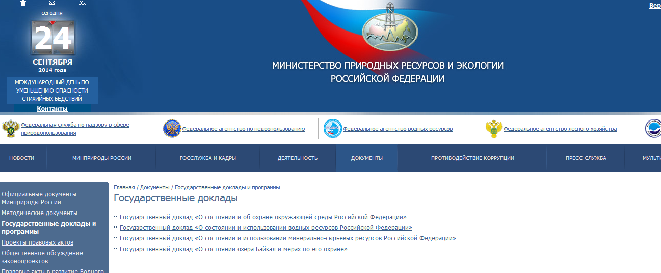
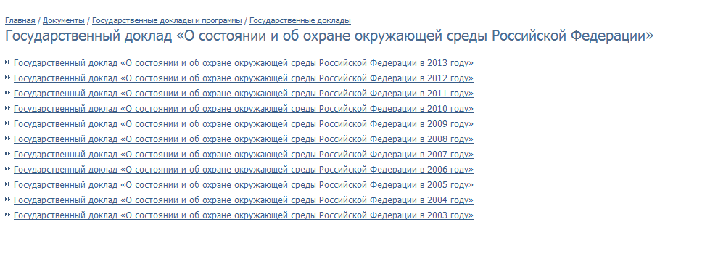
Easy access
http://www.mnr.gov.ru/regulatory/list.php?part=1683

Slide 12
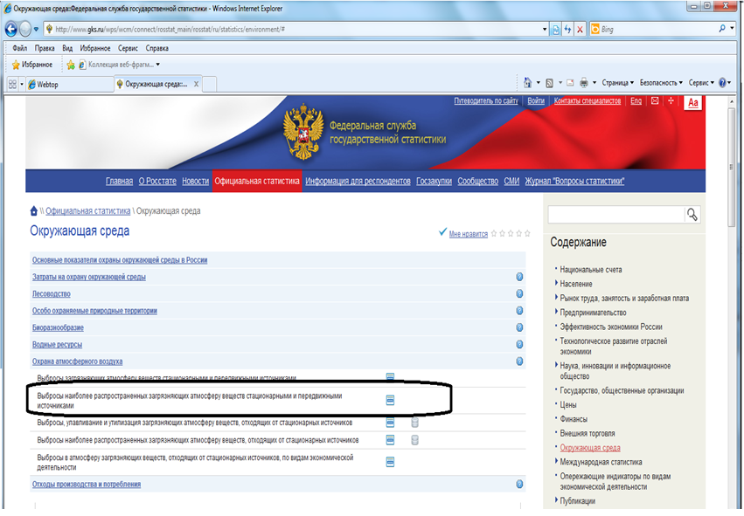
Государственный доклад о со стоянии и об охране окружающей среды (подготавливается и распространяется Минприроды России)
Цель - обеспечение реализации прав граждан на достоверную информацию о состоянии окружающей среды и информационного обеспечения деятельности органов государственной власти РФ, органов государственной власти субъектов РФ, органов местного самоуправления, общественных и иных некоммерческих объединений , юридических и физических лиц
Национальный доклад о кадастре антропогенных выбросов из источников и абсорбции поглотителями парниковых газов, не регулируемых Монреальским протоколом (подготавливается и распространяется Росгидрометом)
http://www.gks.ru/wps/wcm/connect/rosstat_main/rosstat/ru/statistics/environment/#

Slide 13
Legal base and norms for mastering the SNA 2008 and SEEA 2012 in the RF
System of National Accounts 2008; The Central Framework for the System of Environmental and Economic Accounting 2012; The System of Environmental and Economic Accounting of Water Resources 2012, About Land and Ecosystems Accounting, About Energy Accounts.
"Order of the Government of the Russian Federation No. 1911-r of 12.10.2012 "On Amendments to the Federal Statistical Work Plan".
Action Plan for the implementation of works provided by the Government Decree No. 1911-r of 12.10.2012, regarding the assessment of natural resources and accounting of resource productivity (Rosstat order No. 274 of July 8, 2013).
Order of the Government of the Russian Federation No. 1911-r of 12.10.2012.
Order of Rosstat of № 81 30.03.2011 "On approval of the Plan for the development of the System of National Accounts of Russia for the period from 2011 to 2017".

Slide 14
Development of methodological recommendations on formation of indicators for assessment of natural resources
Mineral and water resources – methodologies were developed, discussed at the Scientific-methodological council of Rosstat in 2014. Applied methodologies are being developed by be federal bodies of executive power according the adopted principles.
Unused biological resources – the draft methodology was developed. It is planned to be discussed at meeting of the Scientific-methodological council of Rosstat on March 30 2015.
Land resources – the draft methodology was developed. It is planned to be discussed at meeting of the Scientific-methodological council of Rosstat on March 30 2015.
Unused aquatic biological resources – the development of methodology is planned in 2015.
Assessment of productivity of natural resources– the development of methodology is planned in 2016.

Slide 15
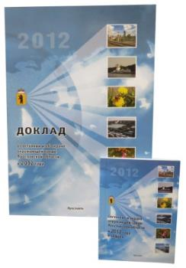
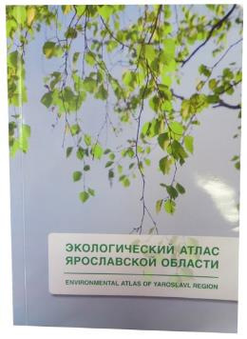
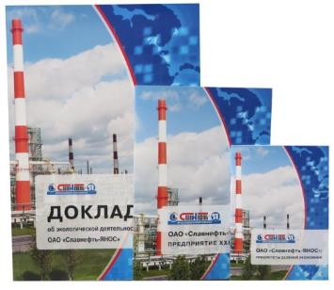
Environmental indicators in regional management: Yaroslavl oblast
Environmental strategy of regional development, environment protection and natural resource reproduction of Yaroslavl oblast
Annual report on the state of the environment
Environmental atlas
Scheme of the analysis – state, impact measures
Thematic fields: 2011 – Sustainable development of Yaroslavl oblast, 2012 – the issue of wastes of production and consumption, 2013 – air pollution
Environmental profile
Environmental changes
Increase of ecological Resilience
Environmental corporate reporting of enterprises
According to Global Reporting Initiative G4

Slide 16
The most important projects on SEEA indicators (experience of the Institute “Cadaster”)
Federal level
Economic valuation of natural capital of the RF and federation subjects | Minprirody of Russia | 2007-2009
Economic valuation of ecosystem services of specially protected areas of the Russian Federation | Minprirody of Russia (within the framework of the target programme “Improvement of the system of specially protected areas of the Russian Federation) | 2010
Regional level
Economic valuation of natural capital of Tomsk, Ryazan, Kaluga, Yaroslavl oblasts, Republic of Northern Osetia-Alania | Minprirody of Russia, Rosprirodnadzor, administrations of federation subjects of RF | The period since 1998
Municipal level
Administrative districts of Yaroslavl, Ryazan, Kaluga, Tomsk, Saratov oblasts, Republic of Northern Osetia-Alania (altogether 9 municipalities) | Rosprirodnadzor, administrations of federation subjects of RF | The period since 1996
Specific specially protected areas (10) | Minprirody of Russia, Rosprirodnadzor, GEF, WWF, ROLL project | The period since 1998

Slide 17
Comparison of Natural Resource Valuation Methods (example of Tomsk Region, RUB Millions)
Indicator | Mineral Resources |  | Water Resources |  | Forest Resources |  |  |  | Biological Resources of Water Bodies |  | Hunting Resources
 |  |  |  |  | Timber |  | Non-Timber
Valuation in the Beginning of the Year | 1,538,697 | 770,867 | 5,265 | 5,217 | 4,517 | 1,135 | 28,429 | 6 | 736 | 7 | 87 | 70
Economic Use of Resources | 47,944 | 24,241 | 167 | 164 | 143 | 36 | 837 | 0 | 23 | 0 | 2 | 2
- Valuation based on resulting profits
- Valuation based on the amount of resource taxes

Slide 18
SEEA in regional management:
Hunting, Tomsk oblast
Less than 20 mln rub
20-40 mln rub
More than 40 mln rub

Slide 19
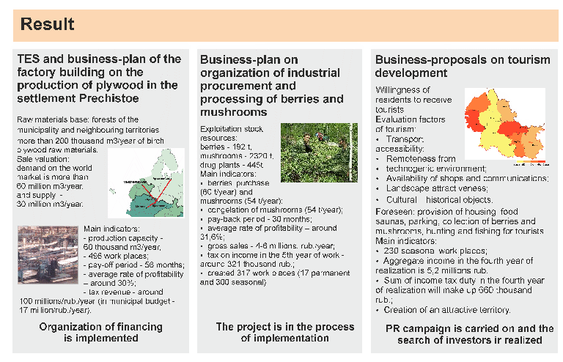
SEEA in municipal management: selection of strategy of transition to “green economy” (Pervomaisky district of Yaroslavl oblast)

Slide 20
Thank you for your attention!

